Slide 1
GRAPHING LINES...
(well sorta)

Slide 2
LAST TIME ON… (GROUP WORK!)

Slide 3
LAST TIME ON… (GROUP WORK!)

Slide 4
LETS DO THE DANG THING!

Slide 5
DO YOU KNOW HOW TO GRAPH LINES?
y=3x+5
y=2x+7
3y+2x=4

Slide 6
AS PROMISED: INEQUALITIES!

Slide 7
AS PROMISED: INEQUALITIES!

Slide 8
AS PROMISED: INEQUALITIES!

Slide 9
AS PROMISED: INEQUALITIES!
How many solutions will it have?

Slide 10
Technology to the Rescue… (for me not you)
Go to https://www.desmos.com/calculator

Slide 11
AS PROMISED: INEQUALITIES!

Slide 12
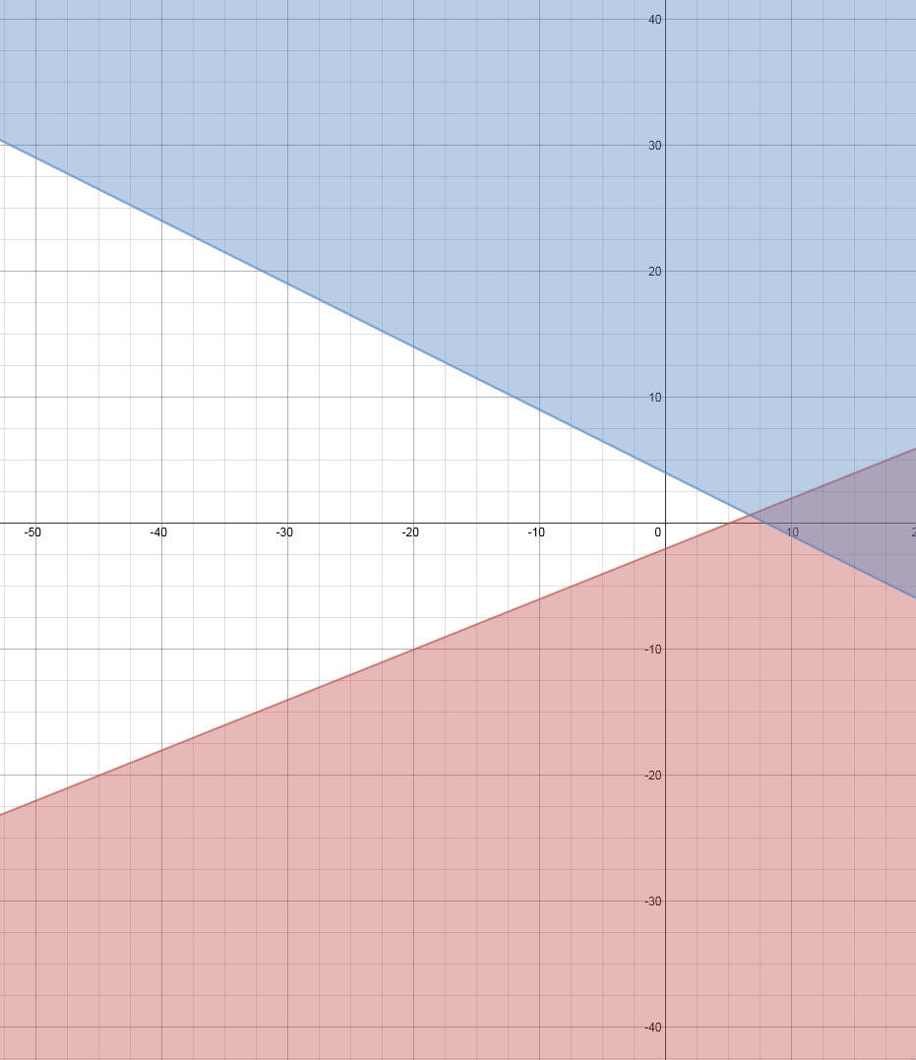
AS PROMISED: INEQUALITIES!
We call this the
feasible region

Slide 13
ALL DEM LINES:

Slide 14
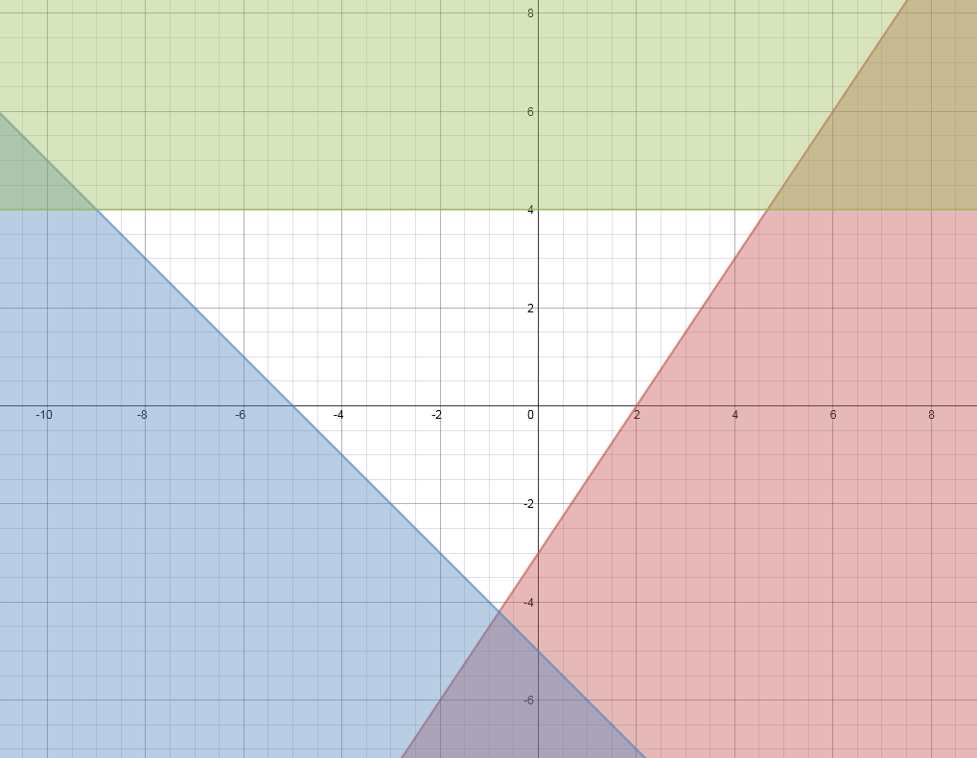
ALL DEM LINES:
Remember this
is the
feasible region

Slide 15
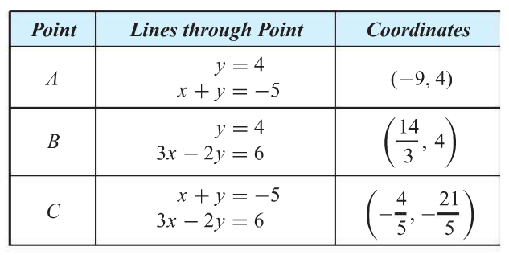
ALL DEM LINES:

Slide 16
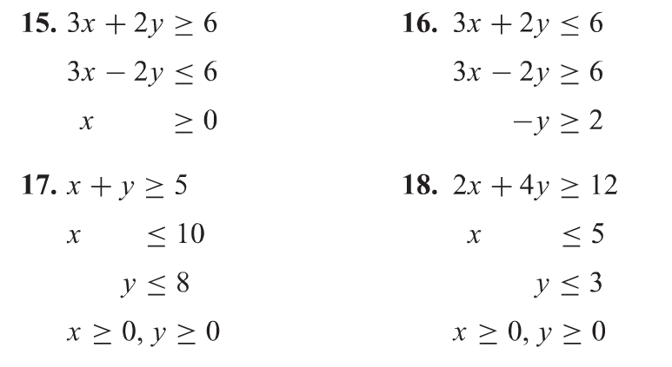
GROUP WORK:

Slide 17
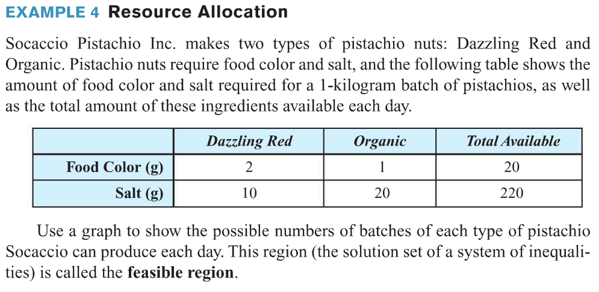
LETS DO THIS!

Slide 18
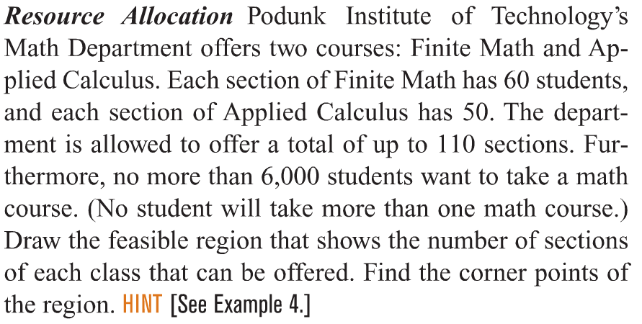
SOME MORE?

Slide 19
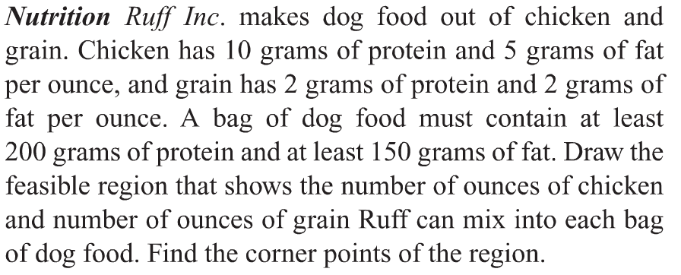
SOME MORE?

Slide 20
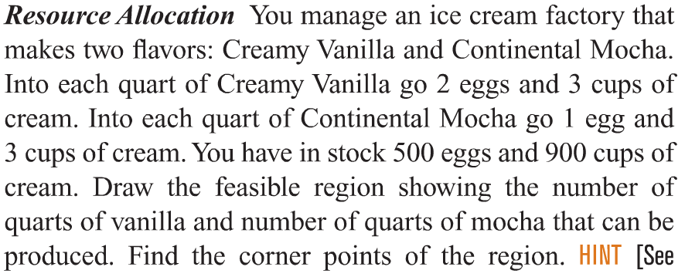
GROUP WORK:

Slide 21
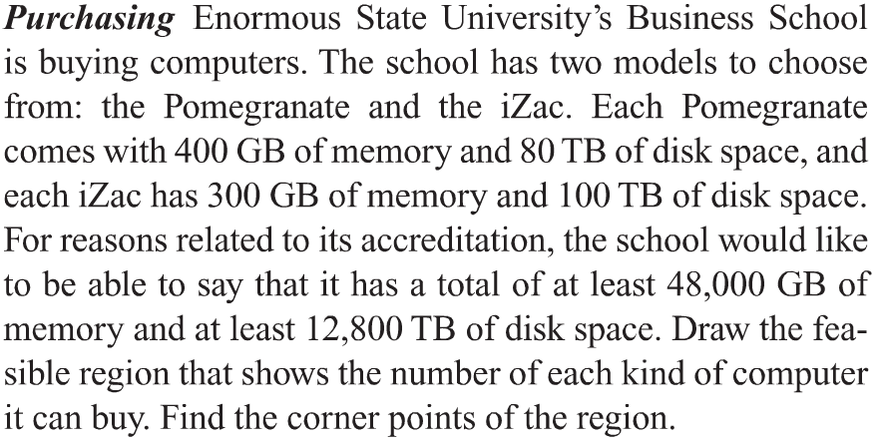
GROUP WORK:

Slide 22
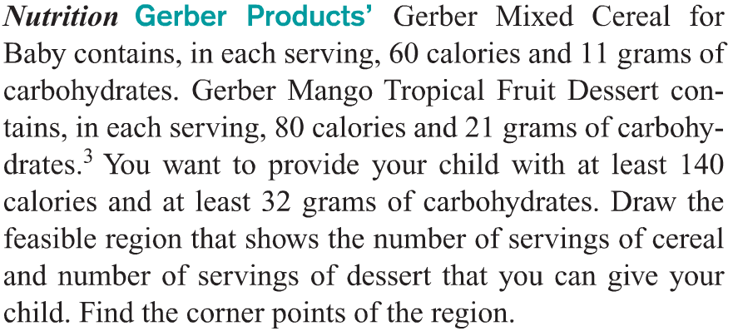
GROUP WORK:

Slide 23
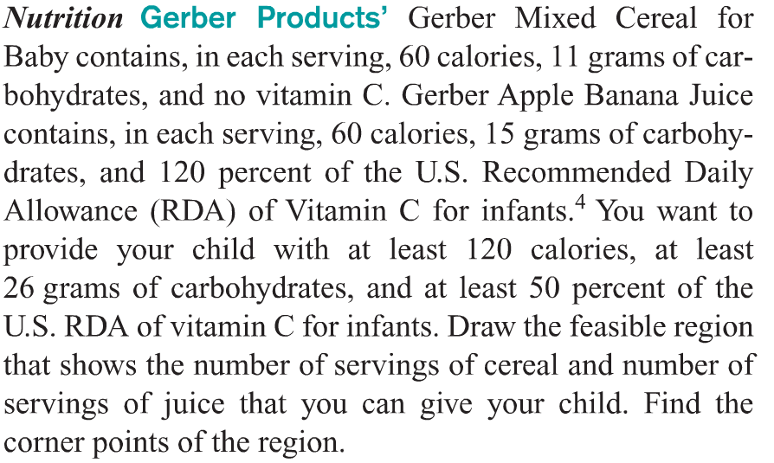
GROUP WORK:

